Slide 1
TRAG
EUREKA IIEC 2026 · SEMI-FINAL
Checking whether reported waste flows are physically possible
Bartol Gracin
Marin Gracin
Roko Rukavina
Mathematics · Faculty of Science
Chemical engineering · FKIT
Mechanical engineering · FSB
Notes:
[Bartol] Good morning. We are three students from the University of Zagreb: mathematics, chemical engineering and mechanical engineering. TRAG checks whether the amounts of waste that treatment plants report each year are physically possible. In the next seven minutes we will show the problem, how the method works, and first results on real Croatian data.

Slide 2
How waste fraud works
01
02
03
Paid to accept waste
Declared as recycled
Stored, buried or dumped
The operator earns a gate fee for every tonne it takes in.
The waste is reported as treated, or as secondary raw material.
The site is abandoned and the public pays for the clean-up.
15–30%
€9.5 bn
of EU waste shipments may be illegal
estimated value per year
Source: EU estimates
Notes:
[Marin] Waste fraud follows a simple pattern. A company is paid to accept waste, reports it as recycled, and then stores, buries or dumps it. When the company disappears, taxpayers pay for the clean-up. EU estimates say 15 to 30 percent of waste shipments may be illegal, worth up to 9.5 billion euros a year. Before the semi-final: confirm the exact source of these two figures so you can name it if asked.

Slide 3
The warning signs were in public data
THE GOSPIĆ CASE · REPORTED FOR 2023
15,574 t
19 t
0
waste treated, almost all plastics (19 12 04, R3)
residual waste reported
reports filed for 2024 and 2025
A licensed plant took waste from Italy, Slovenia and Croatia. Thousands of tonnes piled up, and a criminal investigation began in February 2025.
Source: Croatian Environmental Pollution Register (ROO), public data
Notes:
[Marin] This is a real case. A licensed plant in Gospić reported that it treated 15,574 tonnes of plastic waste in 2023, and that only 19 tonnes of residual waste came out. Then it stopped reporting. Waste piled up on site and part of it was moved to an unlicensed location. A criminal investigation started in February 2025. All three numbers on this slide were public. Nobody checked whether they were physically possible. We present this as a known public case, not as our accusation.

Slide 4
One rule, four checks
input = output + Δ stock + process losses
Mass balance
Partner cross-checks
Data reconciliation per plant and year, with uncertainty ranges
What plant A reports as sent against what plant B reports as received
Physical feasibility
Chemical feasibility
Permitted capacity, storage area, density, machine throughput
Hazardous in, non-hazardous out, only with a process that can do it
Independent sources that are hard to fake: Sentinel-2 satellite images of stockpiles, financial statements, permit history.
Notes:
[Bartol] TRAG starts from one rule of physics: what enters a plant must leave as product or waste, stay in stock, or be lost in the process. On top of that we run four checks: mass balance, cross-checks between trading partners, physical feasibility and chemical feasibility. Paper can be made consistent, so we compare the results with sources that are hard to fake: satellite images of stockpiles, financial statements and permit history. The result is always a deviation to verify, never an accusation.

Slide 5
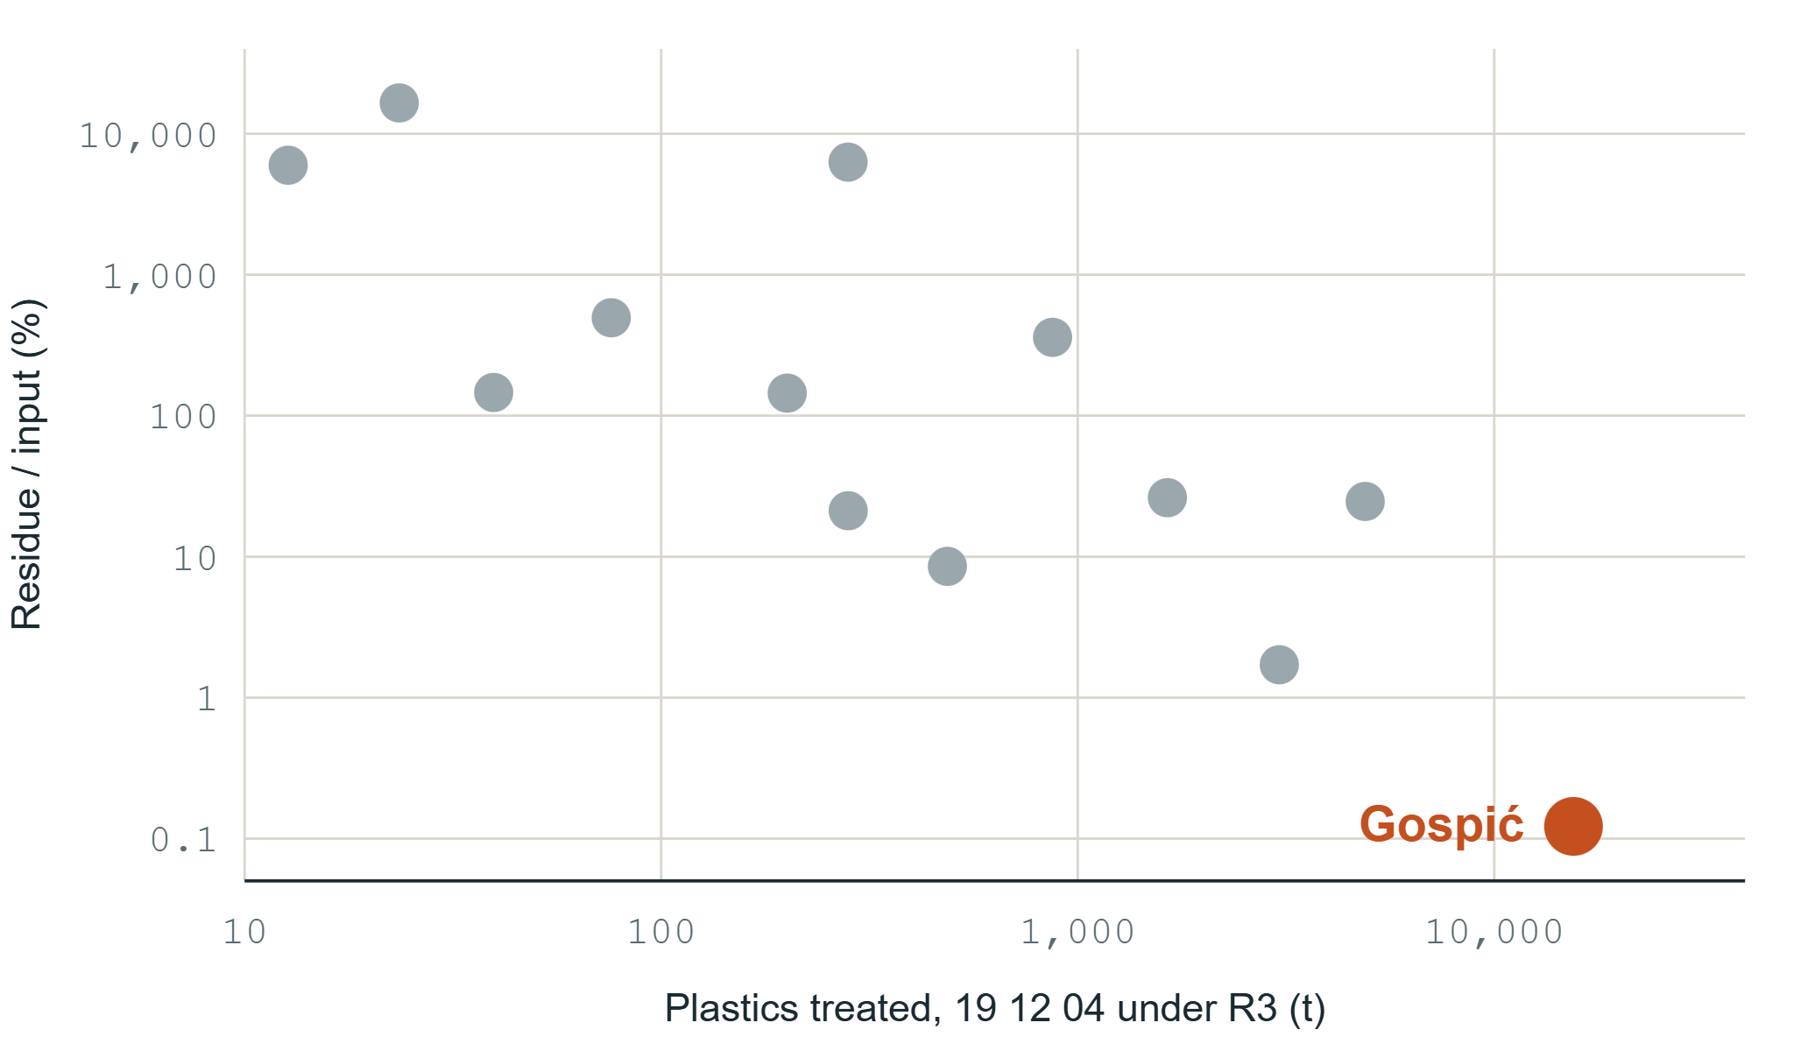
Demo: Gospić stands out among 13 plants
0.12%
residue reported in Gospić, the largest plant of the group
1.7%
next lowest plant
No plant is picked by hand. The code ranks all 13.
ROO 2023 · all plants reporting R3 treatment of waste code 19 12 04 · both axes logarithmic
Notes:
[Bartol] This is our first demo, built only from public data. We took every plant in Croatia that reported recycling plastic waste code 19 12 04 in 2023. There are 13. On the horizontal axis is how much they treated, on the vertical axis how much residual waste they reported, as a share of input. Gospić is the largest and by far the lowest: 0.12 percent. The next lowest plant reports 1.7 percent, fourteen times more. Important: the code does not know which plant is suspicious. It ranks all of them, and Gospić comes out on its own.

Slide 6
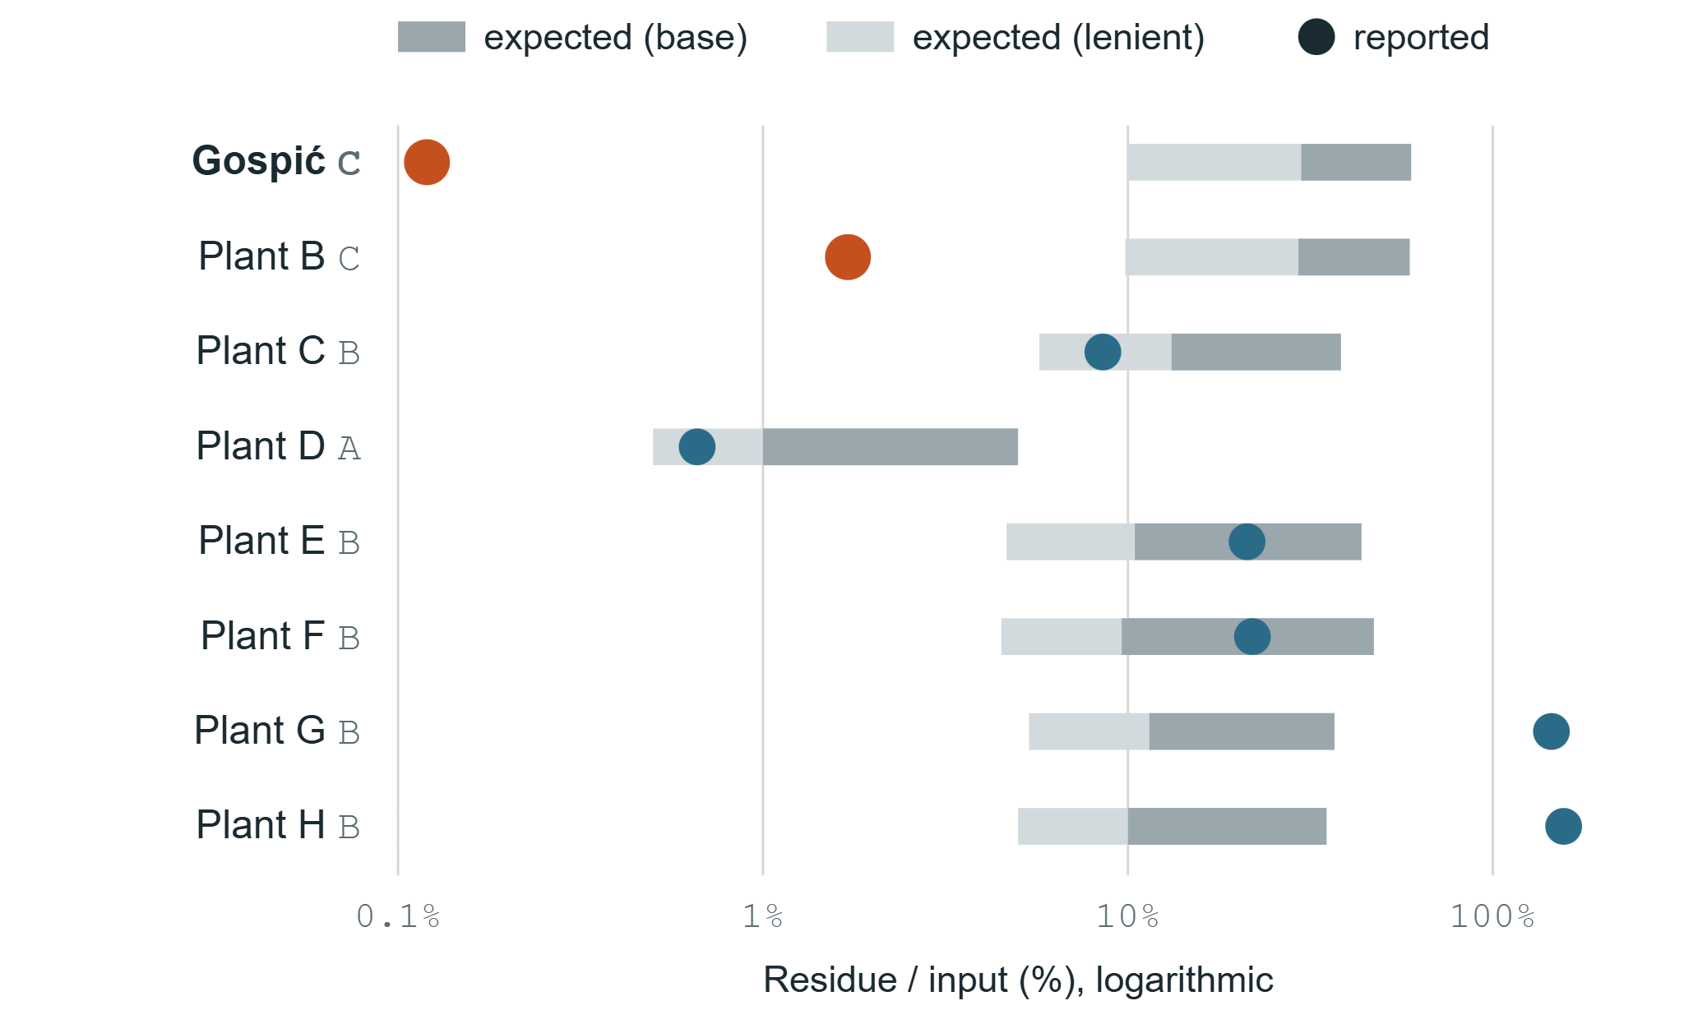
Expected versus reported residue
80–245×
less residue in Gospić than the lowest expected value
Expected range from the type of input: A clean industrial, B sorted packaging, C residues of other sorting plants.
Six of eight plants fall inside the range or within model uncertainty.
ROO 2023 · 8 plants where plastics recycling is at least 80% of treatment · ranges: JRC plant data (Antonopoulos et al. 2021) and team estimates
Notes:
[Roko] A low ratio alone is not proof, because real recyclers sell their product and the register does not record it. So we built a process model. For each plant we look at what kind of plastic came in: clean industrial scrap, sorted packaging, or residues from other sorting plants. Each type has an expected share of residue. For sorted packaging this comes from JRC measurements in European recycling plants; the other ranges are our estimates, and we test them with a strict and a lenient scenario. Gospić reports 80 to 245 times less residue than the lowest expected value, depending on the scenario. One more plant is below the range and needs checking. The other six are inside the range or within the uncertainty of the model. The other plants are shown without names because a deviation is a reason to verify, not a finding.

Slide 7
What exists today
Approach | What it does | What it misses
Electronic consignment notes (e-ONTO, DIWASS) | Records each waste transfer | Does not test whether the numbers can be true
Satellite dump detection (PERIVALLON, EO companies) | Finds illegal dumps in images | Does not link a dump to a plant whose books do not close
Material flow software (STAN, TU Wien) | One-off research studies | Not built for monitoring hundreds of plants every year
We have not found a tool that combines plant-level mass balance, process models and independent sources.
Notes:
[Marin] Tools for parts of this problem exist. Electronic consignment notes record every transfer but do not check whether the numbers are possible. Satellite projects such as PERIVALLON at Politecnico di Milano find illegal dumps, but cannot say which plant's books do not close. Material flow software is used for one-off research. We have not found a tool that combines all three for continuous monitoring. Satellite companies are potential partners for us, not only competitors: TRAG tells them where to look.

Slide 8
Who would use it
Inspection authorities
Banks and insurers
New Croatian law introduces risk-based inspections
Issue financial guarantees for waste operators
Research pilot, then licence
Monitoring subscription
Cement plants and industrial buyers
Waste producers and shippers
Need reliable suppliers of waste-derived fuel and raw materials
Legally responsible for where their waste ends up
Due-diligence reports
Due-diligence reports
We do not sell to the plants we monitor. A free public index builds trust; prices are hypotheses we will test in interviews.
Notes:
[Roko] Who would use this? Inspection authorities first: new Croatian law introduces risk-based inspections, and TRAG is a risk ranking. Banks and insurers that issue guarantees for waste operators carry the loss when a site is abandoned. Cement plants buy waste-derived fuel and need to trust their suppliers. Waste producers and foreign shippers are legally responsible for where their waste ends up. We deliberately do not sell to the plants we monitor. During the student phase there is no revenue; the prices in our business plan are hypotheses to test with these customers.

Slide 9
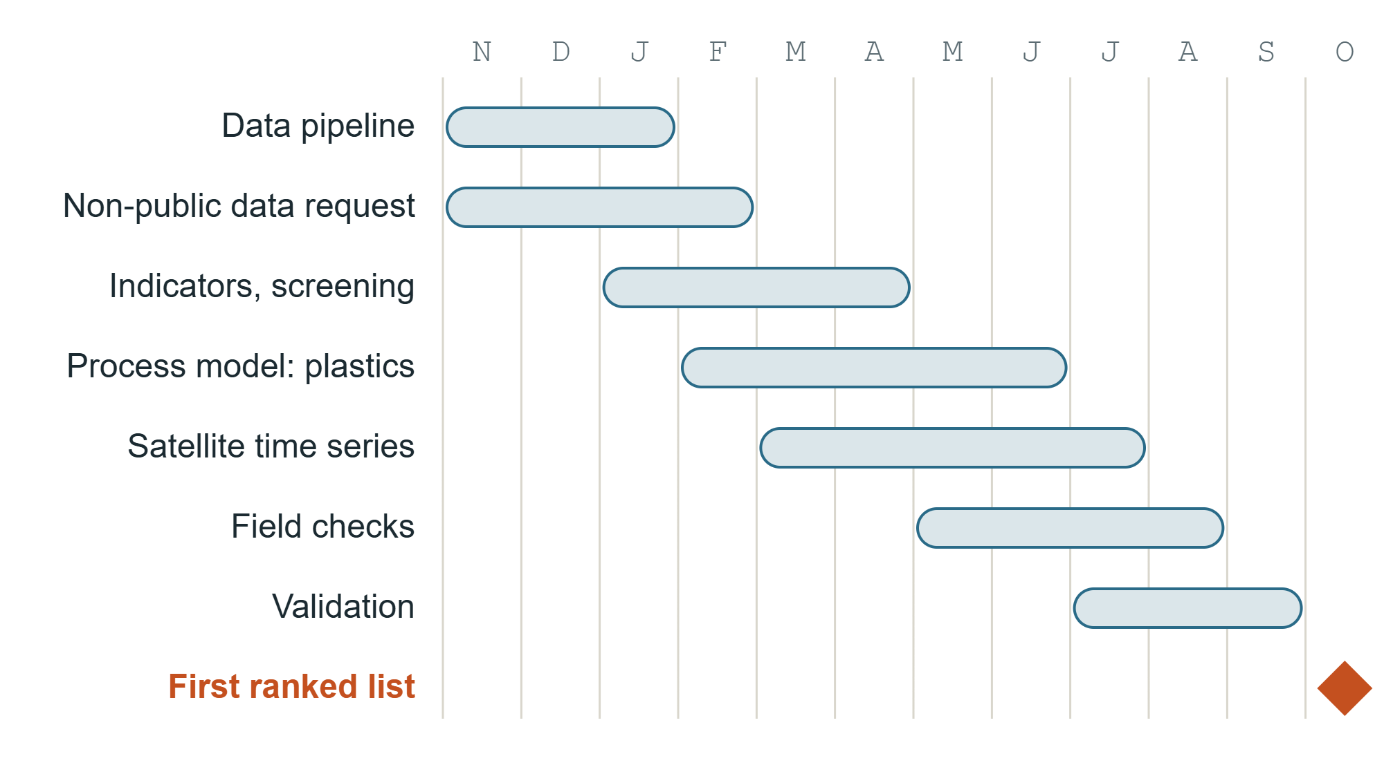
12-month plan and costs
Item | €
Drone (0 € if borrowed from FSB) | 1,500
High-resolution satellite images | 1,500
Field visits | 800
Competition and conference | 800
Computing and software | 400
Total | 5,000
Team work is unpaid. Register data, permits and Sentinel-2 images are free.
Notes:
[Bartol] The prototype takes twelve months, from November to October. We start with the data pipeline for 2015 to 2025 and, in the first month, a request to the Ministry for the non-public parts of the register: stocks, transfers between partners and exports. Then screening, the plastics process model, satellite time series and field checks. Before anything is shared, we validate the ranking on known cases such as revoked permits, inspection findings and court decisions. The first ranked list for Croatia is planned for October 2027. The prototype costs about five thousand euros, mostly for independent evidence: a drone and high-resolution satellite images. Our own work is unpaid and the core data is free.

Slide 10
From one case to every plant
Other EU countries
Other waste streams
Next steps
Every member state keeps a similar register. Since May 2026, DIWASS adds EU-wide shipment data.
The same engine works for electronics, tyres, batteries, solvents and sewage sludge.
Request non-public register data, validate on known cases, run all years 2015–2025.
TRAG
bartolgracin@gmail.com
Notes:
[Roko] Croatia is our test market, about 450 treatment sites. Every EU member state keeps a similar register, and since May 2026 cross-border shipments go through the electronic DIWASS system, so the method transfers. The same engine also works for other waste streams: electronics, tyres, batteries, solvents and sewage sludge. Our next steps are the request for non-public register data, validation on known cases, and running all years from 2015. [Bartol] Thank you. We are happy to answer your questions.

